Slide 1
Module 1.4 – Course Introduction
‘Jet’ Overview

Slide 2
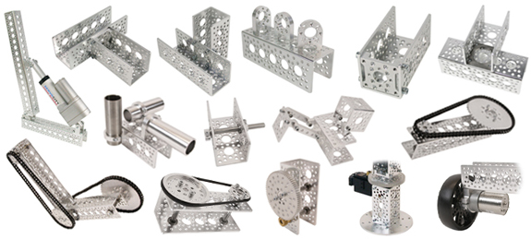
Jet Overview - Chassis
Jet chassis is constructed using Actobotics parts
These are machined metal parts with various aluminum channel, hubs, wheels, and brackets
Notes:
The chassis of Jet is constructed using Actobotics parts
Actobotics is a line of machine aluminum and steel components that can attach in various ways

Slide 3
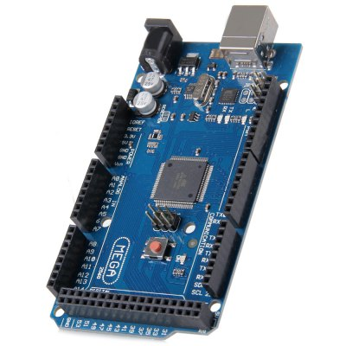
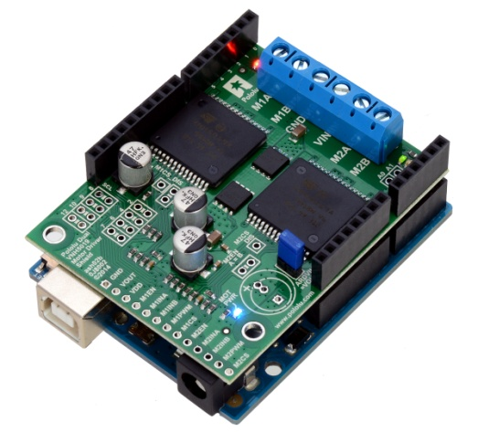
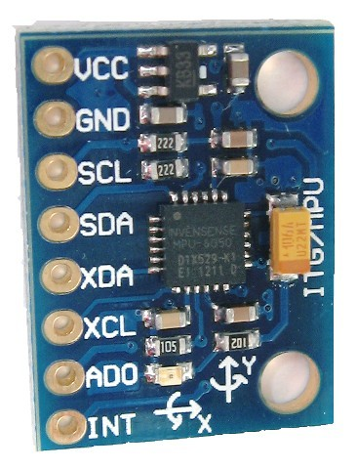
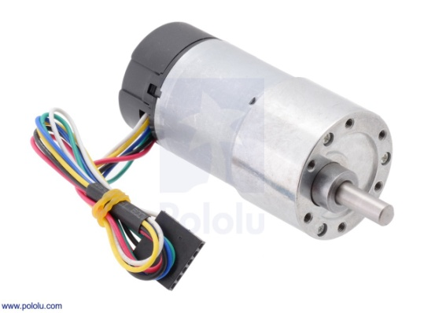
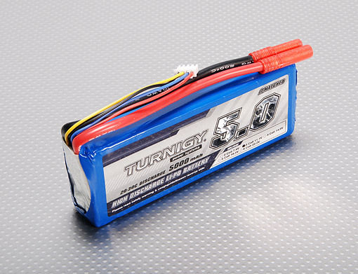
Jet Overview - Electronics
Jet electronics consist of
NVIDIA Jetson TX1/TK1
Arduino Mega
Pololu H-bridge and motors
3 sonar sensors
GY-521 accelerometer/gyroscope
Logitech camera
3S (11.1V) 5000mAh battery
Notes:
Jet electronics consists of various electronic components that when connected are the sensing, processing, and actuating system of Jet.
The components are listed here and the next slides will go over each component in detail.

Slide 4


Jet Overview - Software
Jet runs ROS
ROS is the Robot Operating System which is middleware that runs on Linux
Notes:
The primary software for Jet is written to utilize ROS, the robot operating system. This will be described in another lecture.

Slide 5
Jet Overview – Architecture Diagram
Jetson TX1/TK1
Camera
Encoder
readings
USB
Left
Motor
USB
H-Bridge
Shield
Arduino
Mega
Right
Motor
I²C
Accel/Gyro (GY-521)
Sonar
Module
Sonar
Module
Sonar
Module
Notes:
The Jetson TX1/TK1 is the primary controller for Jet. The TX1/TK1 runs Ubuntu Linux and ROS.
The Arduino Mega serves as the embedded controller for Jet. It reads the sensors and drives the motors. The TX1/TK1 and the Arduino Mega communicate over USB.
The H-bridge shield stacks on top of the Arduino Mega. 2 wires from each of the motors connects to the screw terminals of the H-bridge shield.
The encoder readings from each motor are sent to the Arduino Mega.
Each of the sonar modules has a 4-pin header. 2 of those 4-pins are power (5V) and ground. The other 2 pins of each header goes to the sensor shield.
The GY-521 is the accelerometer/gyroscope unit. It requires power and ground and is connect to the I2C bus on the Arduino Mega.

Slide 6
Jet Overview – Power Supply
Jetson TX1/TK1
Red
Power
Switch
3S (11.1V) 5000mAh Battery
USB
Fuse
H-Bridge
Shield
Arduino
Mega
Notes:
The battery first runs through a fuse and then runs through the red power switch.
After the power switch, the main power is split to supply power to the Jetson TX1/TK1 and to supply motor power to the H-bridge.

Slide 7
Jet Do’s and Don’ts
Do
Charge the battery using the correct LiPo charger and be sure Jet is turned off when charging
When possible, turn off the TX1/TK1 first by pressing the black TX1/TK1 power button
It may take a second before the TX1/TK1 turns off
You can then press the red power button to turn off main power
It is recommended to attach some bumper material to the front of Jet
Don’t
Run the robot in a manner to stall the motors
Run the robot at too high a speed

Slide 8
The GPU Teaching Kit is licensed by NVIDIA and California Polytechnic State University under the Creative Commons Attribution-NonCommercial 4.0 International License.

